Slide 1


          University of Diyala
          College of Engineering
          Department of Electronics Engineering
Course Number: U103
Course Name: Computer Networks
Lecture (10)
Asst. Lect. Ahmed Mohammed Ahmed

Slide 2
TCP/IP PROTOCOL SUITE
The TCP/IP protocol suite was developed prior to the OSI model. Therefore, the layers in the TCP/IP protocol suite do not exactly match those in the OSI model. The original TCP/IP protocol suite was defined as having four layers: host-to-network, internet, transport, and application. However, when TCP/IP is compared to OSI, we can say that the host-to-network layer is equivalent to the combination of the physical and data link layers. The internet layer is equivalent to the network layer, and the application layer is roughly doing the job of the session, presentation, and application layers with the transport layer in TCP/IP taking care of part of the duties of the session layer.
So, we assume that the TCP/IP protocol suite is made of five layers: physical, data link, network, transport, and application. The first four layers provide physical standards, network interfaces, internetworking, and transport functions that correspond to the first four layers of the OSI model. The three topmost layers in the OSI model, however, are represented in TCP/IP by a single layer called the application layer (see Figure 10.1).

Slide 3
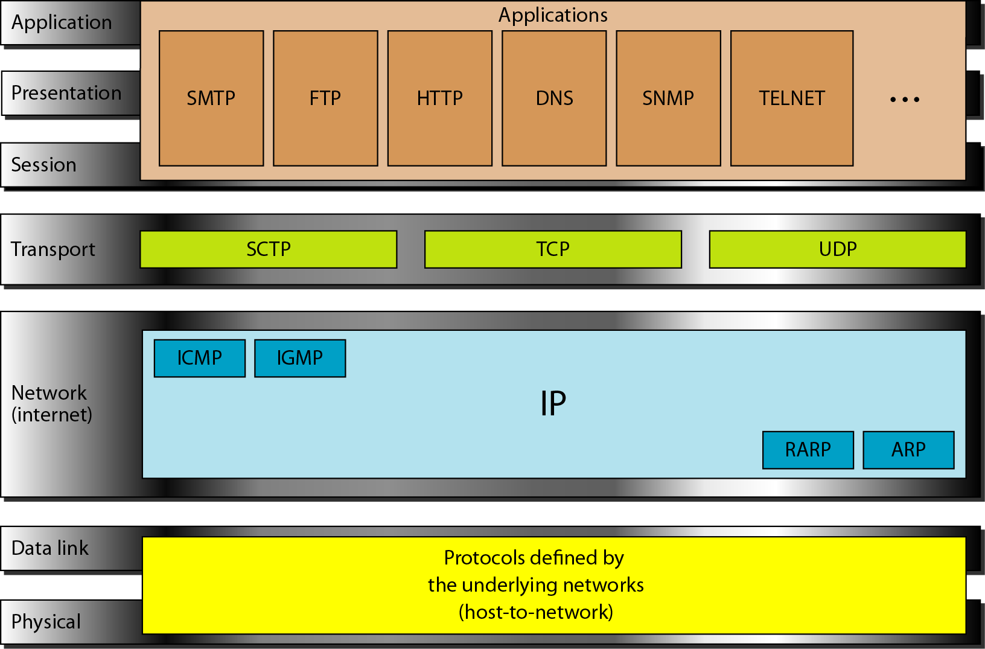

Slide 4
TCP/IP is a hierarchical protocol made up of interactive modules, each of which provides a specific functionality. The term hierarchical means that each upper-level protocol is supported by one or more lower-level protocols.
At the transport layer, TCP/IP defines three protocols: Transmission Control Protocol (TCP), User Datagram Protocol (UDP), and Stream Control Transmission Protocol (SCTP). At the network layer, the main protocol defined by TCP/IP is the Internetworking Protocol (IP); there are also some other protocols that support data movement in this layer.
Physical and Data Link Layers: - At the physical and data link layers, TCP/IP does not define any specific protocol. It supports all the standard and proprietary protocols. A network in a TCP/IP internetwork can be a local-area network or a wide-area network.
Network Layer: - At the network layer (or, more accurately, the internetwork layer), TCP/IP supports the Internetworking Protocol. IP, in turn, uses four supporting protocols: ARP, RARP, ICMP, and IGMP.

Slide 5
Internetworking Protocol (IP):-The Internetworking Protocol (IP) is the transmission mechanism used by the TCP/IP protocols. It is an unreliable and connectionless protocol-a best-effort delivery service. The term best effort means that IP provides no error checking or tracking. IP assumes the unreliability of the underlying layers and does its best to get a transmission through to its destination, but with no guarantees. IP transports data in packets called datagrams, each of which is transported separately. Datagrams can travel along different routes and can arrive out of sequence or be duplicated. IP does not keep track of the routes and has no facility for reordering datagrams once they arrive at their destination. The limited functionality of IP should not be considered a weakness, however. IP provides bare-bones transmission functions that free the user to add only those facilities necessary for a given application and thereby allows for maximum efficiency.
Address Resolution Protocol: - The Address Resolution Protocol (ARP) is used to associate a logical address with a physical address. On a typical physical network, such as a LAN, each device on a link is identified by a physical or station address, usually imprinted on the network interface card (NIC). ARP is used to find the physical address of the node when its Internet address is known.
Reverse Address Resolution Protocol: - The Reverse Address Resolution Protocol (RARP) allows a host to discover its Internet address when it knows only its physical address. It is used when a computer is connected to a network for the first time or when a diskless computer is booted.
Internet Control Message Protocol: - The Internet Control Message Protocol (ICMP) is a mechanism used by hosts and gateways to send notification of datagram problems back to the sender. ICMP sends query and error reporting messages.
Internet Group Message Protocol:-The Internet Group Message Protocol (IGMP) is used to facilitate the simultaneous transmission of a message to a group of recipients.

Slide 6
Transport Layer: - Traditionally the transport layer was represented in TCP/IP by two protocols: TCP and UDP. IP is a host-to-host protocol, meaning that it can deliver a packet from one physical device to another. UDP and TCP are transport level protocols responsible for delivery of a message from a process (running program) to another process. A new transport layer protocol, SCTP, has been devised to meet the needs of some newer applications.
User Datagram Protocol: - The User Datagram Protocol (UDP) is the simpler of the two standard TCP/IP transport protocols. It is a process-to-process protocol that adds only port addresses, checksum error control, and length information to the data from the upper layer.
Transmission Control Protocol: - The Transmission Control Protocol (TCP) provides full transport-layer services to applications. TCP is a reliable stream transport protocol. The term stream, in this context, means connection-oriented: A connection must be established between both ends of a transmission before either can transmit data. At the sending end of each transmission, TCP divides a stream of data into smaller units called segments. Each segment includes a sequence number for reordering after receipt, together with an acknowledgment number for the segments received. Segments are carried across the internet inside of IP datagrams. At the receiving end, TCP collects each datagram as it comes in and reorders the transmission based on sequence numbers.
Stream Control Transmission Protocol: - The Stream Control Transmission Protocol (SCTP) provides support for newer applications such as voice over the Internet. It is a transport layer protocol that combines the best features of UDP and TCP.

Slide 7
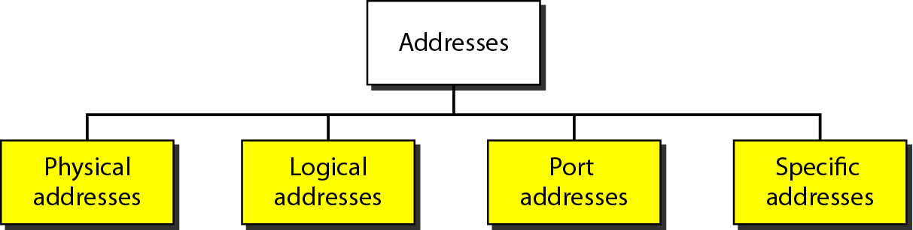
ADDRESSING
Four levels of addresses are used in an internet employing the TCP/IP protocols: physical (link) addresses, logical (IP) addresses, port addresses, and specific addresses, see Figure (10.2).

Slide 8
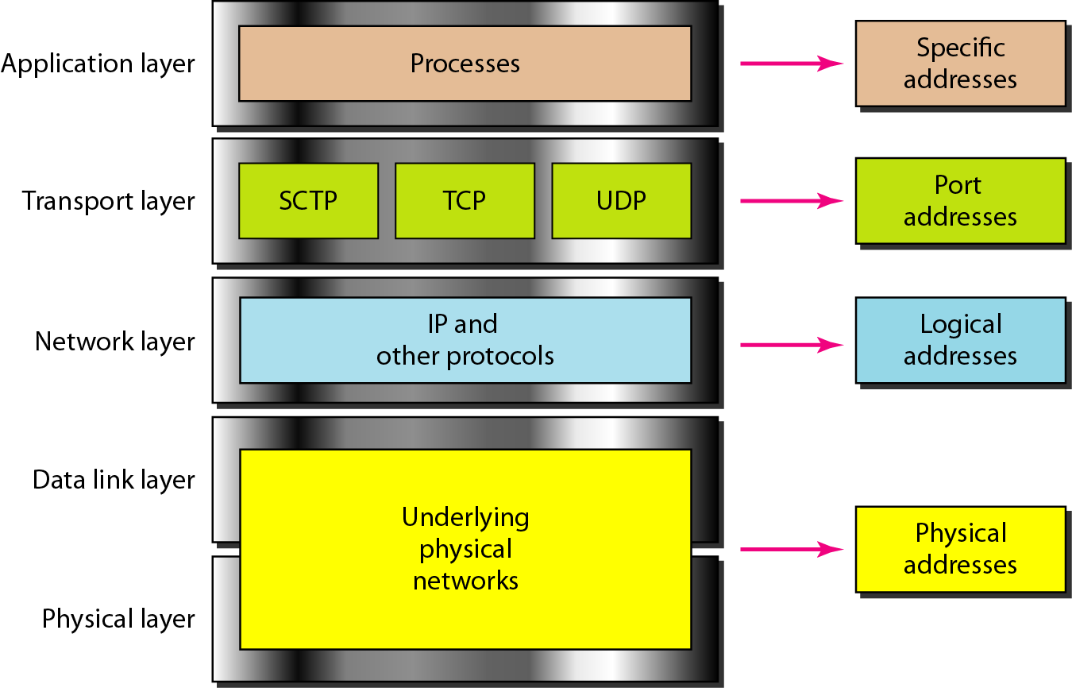

Slide 9
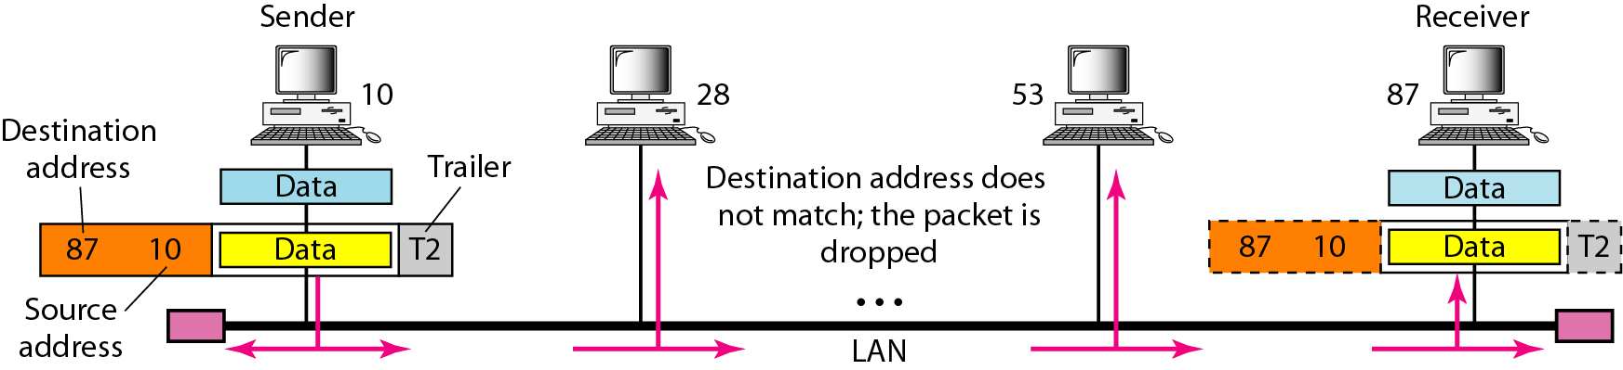

Slide 10
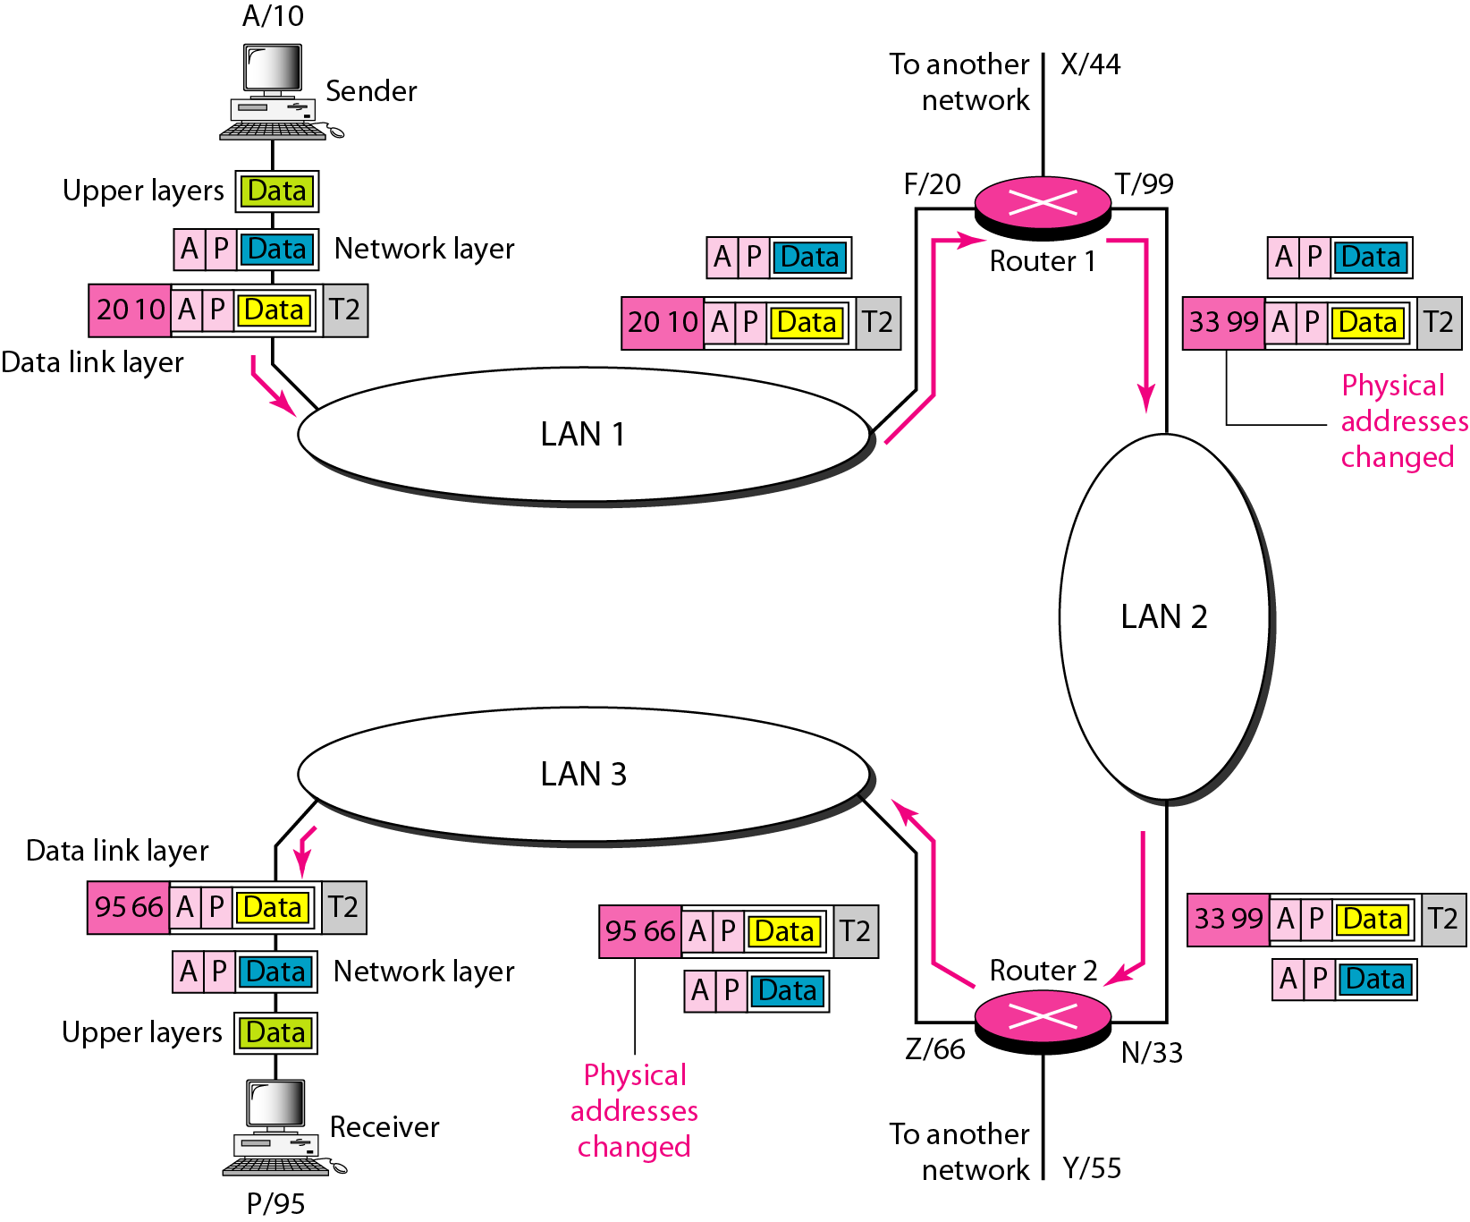

Slide 11
